Slide 1
Using the representational framework to characterize top-down feedback
Project Members: Zhukaixing Li; Danting Meng; Huadong Xiong; Ziang Yu.
Mentor: Laure Busse

Slide 2
Introduction
Background:
Top-down feedback play a significant role in brain.
Neurons in high-level brain areas show complex responses pattern, because they encode task-relevant information (M Rigotti et al, 2013).
High-level area in brain should express these task-relevant information to regulate downstream area by feedback.
To characterize these complex pattern about feedback, we could map these spatial activity patterns to representational geometry (N Kriegeskorte & J Diedrichsen, 2019).
Question:
How can we characterize the feedback information in representational level?

Slide 3
Idea
Rationale
In order to implement feedback, the brain should express the feedback in representation.
There should be more information in the representation, since the feedback adds complexity.
How is this feedback information be expressed in representational level?
我们想知道这个问题是怎么被NN 解决的，通过这个了解这个问题是怎么被大脑解决。
Hypothesis
Feedback should increase the representational complexity in some brain area.
We want to characterize this increased representational complexity.
Notes:
有什么问题是只有feedback才能解决的吗？多次决策

Slide 4
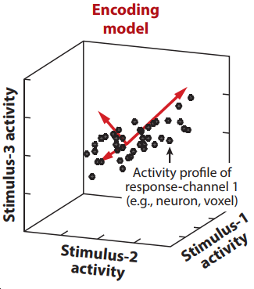
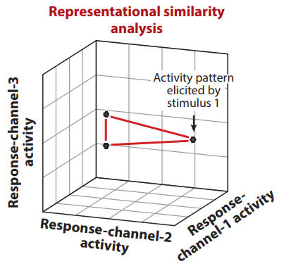
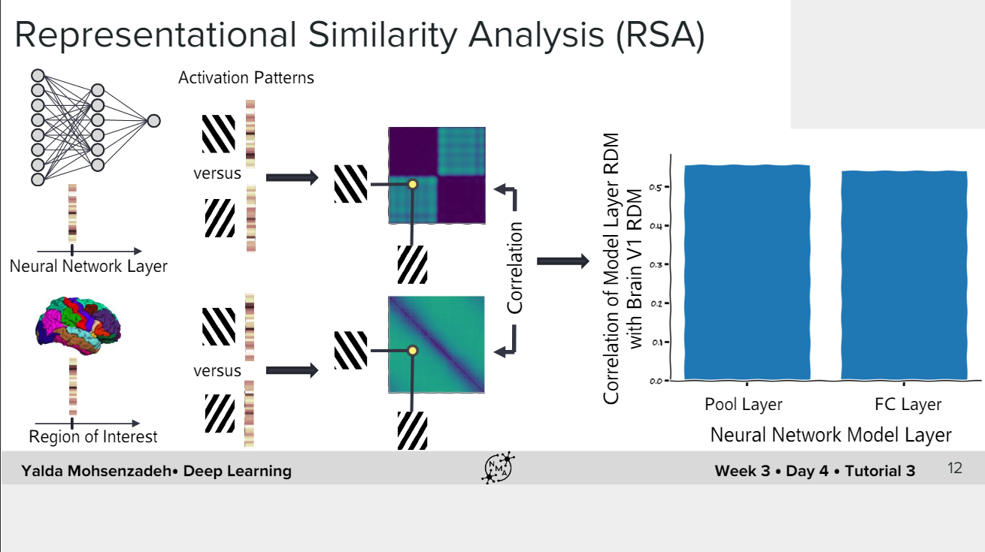
Quantify information in representational level
Model activity-profile distribution
Model representational distances
Find some tasks.
Train the neural network using these tasks and find equivalent dataset in brain.
Compare the behavior and activity dynamics between brain and neural network with and without feedback.

Slide 5
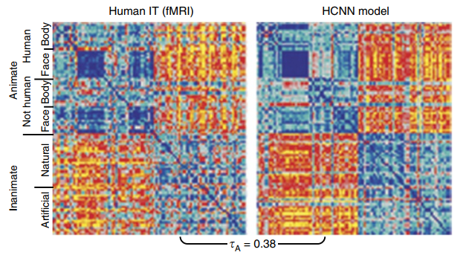
Why neural network?
Given some tasks and similar structures as brain, the neural network has similar neural activity with brain in representational geometry.
We can easily open the black box and manipulate neural network, to explore the computational mechanism.

Slide 6
Neural network
Abstract
Convolutional neural network with no feedback.
Recurrent convolutional neural networks with lateral and feedback connections (CJ Spoerer et al. 2017; J Kubilius et al. 2019; K Kar et al. 2019; TC Kietzmann et al. 2019).
Excitatory-inhibitory recurrent convolutional neural networks with lateral and feedback connections (HF Song et al. 2016, GR Yang et al. 2019, NY Masse et al. 2019, GR Yang & XJ Wang 2020).
Flexibility in structure, easy to interpret in mechanistic level, fast to train.
Can’t solve hard task(e.g. object detection), so we need to design cognitive tasks.
Biologically plausible
Notes:
Pytorch中已经实现的预训练模型：
https://pytorch.org/tutorials/beginner/finetuning_torchvision_models_tutorial.html
https://pytorch.org/docs/stable/torchvision/models.html
https://pytorch.org/tutorials/beginner/transfer_learning_tutorial.html
第三个也有一些还没有文档的代码实现，分别是汪小京的两个学生杨光宇和Murray做的。
https://github.com/gyyang/multitask
https://github.com/murraylab/PsychRNN

Slide 7
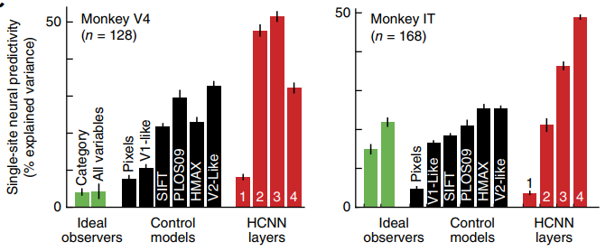
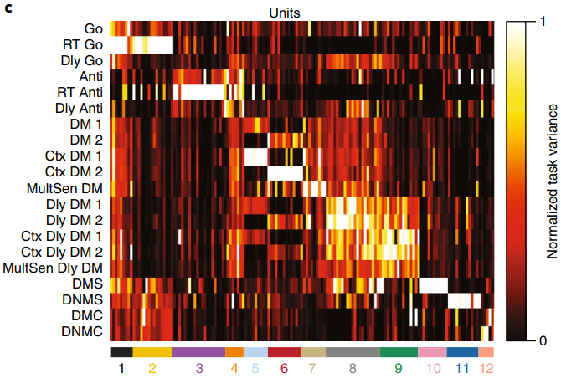
Analysis
Given some tasks, compare neural network model with or without feedback and brain in terms of behavior and activity dynamics in representation level (Kriegeskorte 2015, Kriegeskorte & Diedrichsen 2016, Yamins & DiCarlo 2016, Paninski & Cunningham 2017).
Performance
Connectivity
Representation dissimilarity matrix
Representation invariance across tasks.
……

Slide 8
Task: object detection
We don’t have enough GPU resource, we can only use Google Colab.
We can’t use NLP as our model, so semantic tasks are excluded.
We can’t train on huge dataset or NN model.
Our choice for NN task are limited within pretrain, small scale neural network in vision area.
We can’t do experiment, so we can only use accessible dataset.
Object detection in vision domain is one of the most popular topic.

Slide 9
fMRI Datasets with object detection
Kay/Gallant Dataset: No labels
BOLD5000: Need long time to process.
Other datasets from Olivalab
The Natural Scenes Dataset (NSD) : Not released yet.
HCP: working memory task data (0-back)
4 categories: face, body parts, tools, and places.
But the representations include two items.

Slide 10
1. Compare RDM between pretrained neural network and human
Compare neural network and brain in terms of behavior and activity dynamics in representational level(Khaligh-Razavi & Kriegeskorte 2014, Kriegeskorte 2015):
Use pretrained neural network(ResNet-18, VGG, SSD) to perform the same task as in human fMRI data.
Compare representation dissimilarity matrix in different layers and performance.
Goal:
Get familiar with neural network and data analysis.

Slide 11
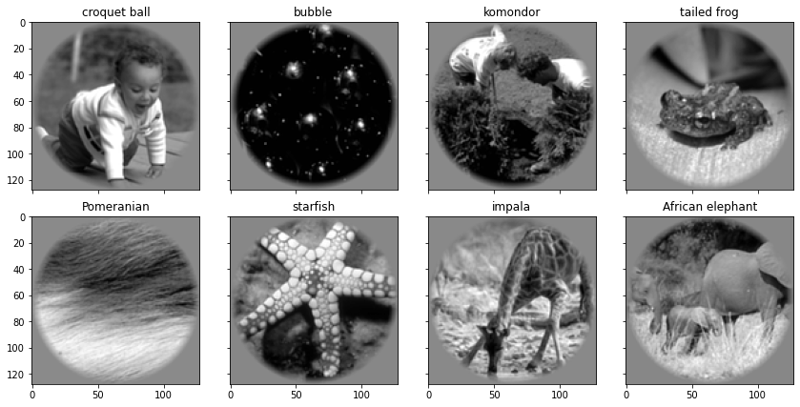
Kay/Gallant Dataset
Dataset: Kay/Gallant [middle right]
Subjects passively watch the stimuli in fMRI scanner.
We labeled the stimuli into 4 categories by hand: animate-animals, animate-human, inanimate-artificial, inanimate-natural (Khaligh-Razavi & Kriegeskorte 2014).
We assume all stimuli in the same category elicit a prototypical response pattern, which implies small dissimilarities between within-category representations.
We believe stimuli may be clustered in representational geometer according the semantic meaning.

Slide 12
Compute representation dissimilarity matrix
Euclidean distance precisely defines the discriminability of a pair of stimuli.
Linear: this is a biologically plausible computation for a single neuron, the information a downstream neuron might extract from a neural population.
Nonlinear: the information in this brain area (even can’t decoded by brain).
Representational geometry reflects how differently the stimuli are encoded.
Given limited neurons, more information vs more robust coding:
If you want more information, the coding scheme shouldn’t have gradient, is high-dimensional, not smooth and not differentiable, and requires less cells (grandmother cells).
If you want more robust coding, the coding scheme should have gradient, is low-dimensional, smooth and differentiable, but requires much more cells (population coding).

Slide 13
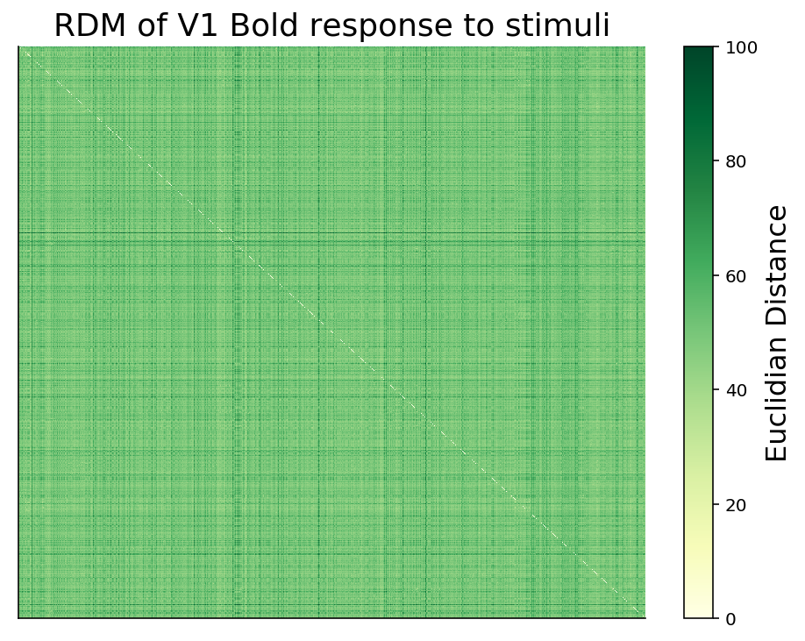
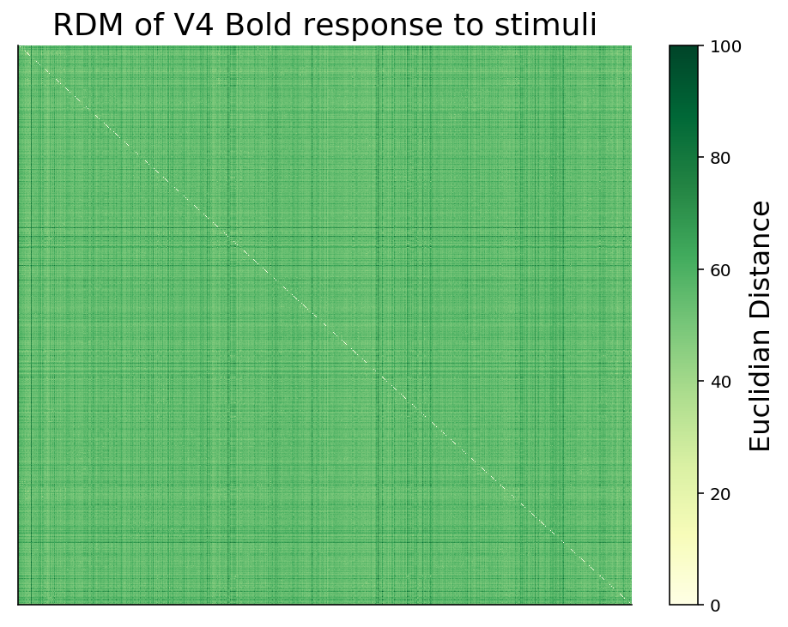
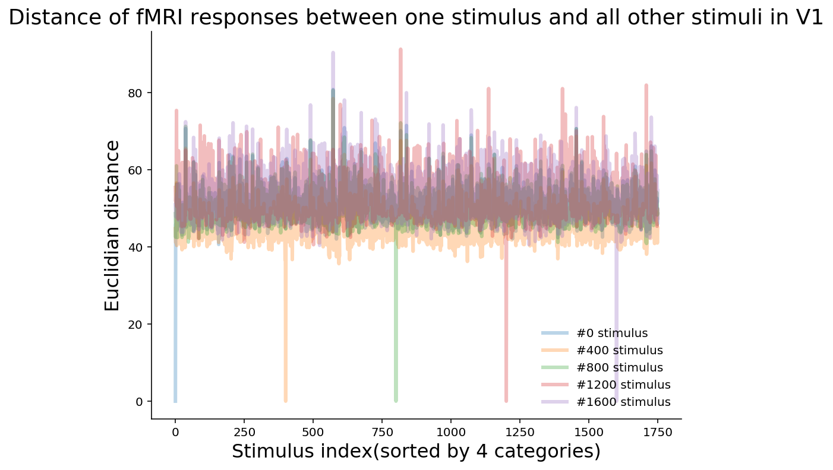
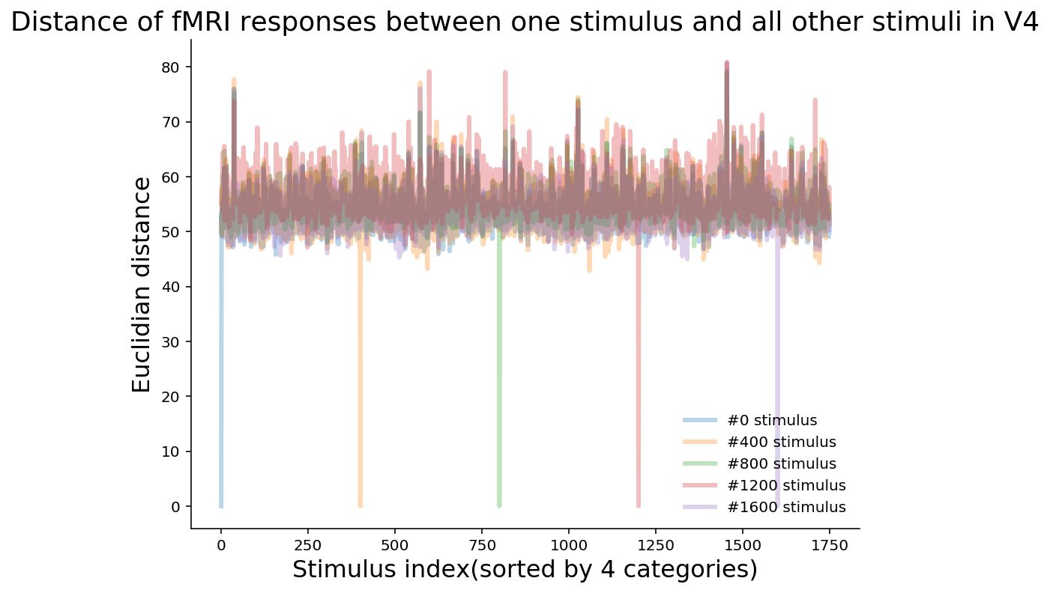
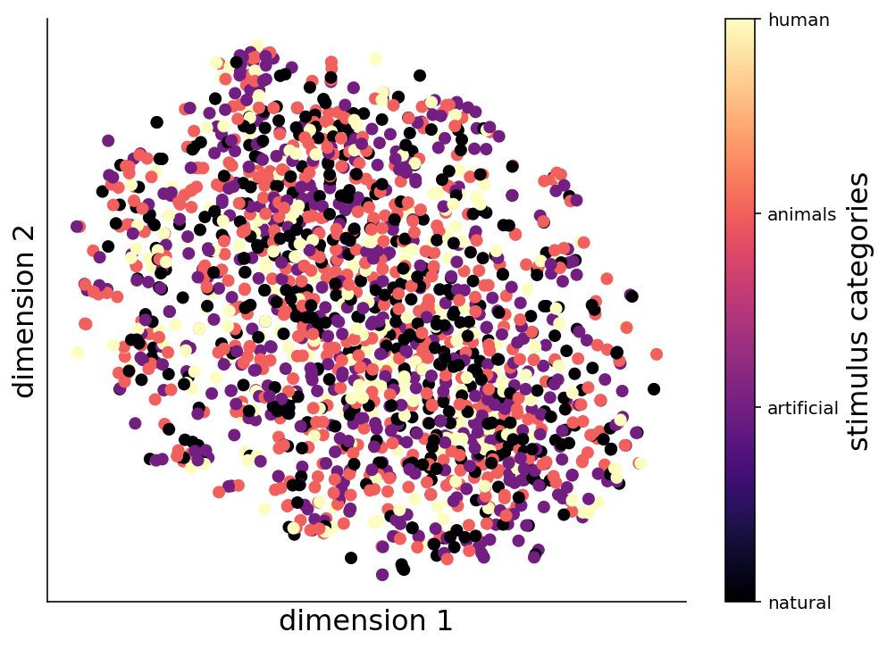
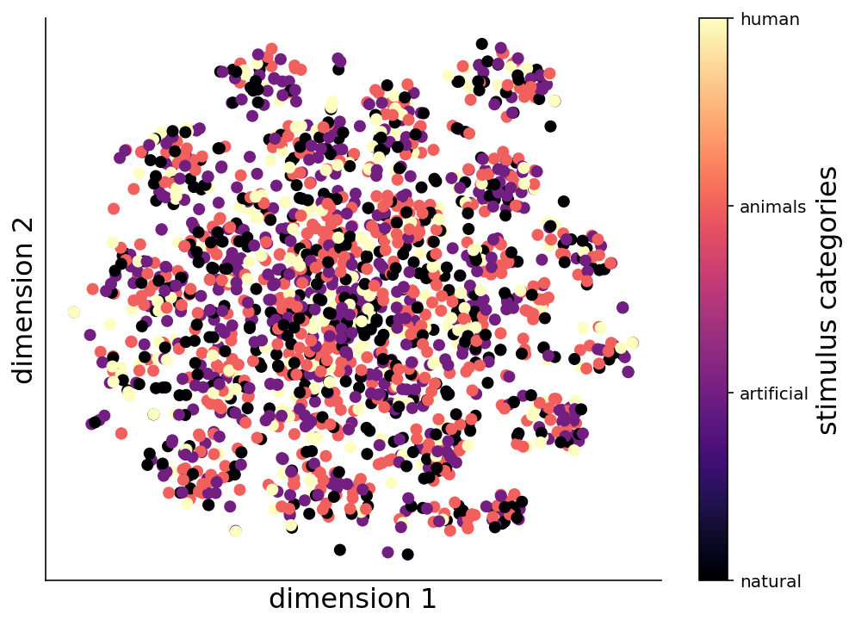
Compute representational dissimilarity matrix in brain
natural
inanimate
artificial
animals
Representation dissimilarity matrix of the fMRI data
A stimuli(1750) x stimuli(1750) matrix, stimuli are sorted by 4 categories.
The stimuli have an almost equally long distance from each other[top&middle right], suggesting the encoding is high-dimensional.
The result seems plausible in V1: brain doesn’t cluster the stimuli by their semantics in early visual cortex. But there should be some clusters in V4.
Why?
We don’t have data in high-level brain areas, where the result may be different.
Stimuli are unclear and hard to identify, thus the process may be purely perceptual. Subjects couldn't use smooth coding scheme to encode.
The spatial activity of fMRI evoked by the stimuli in early visual cortex can’t be clustered by non-linear unsupervised method[bottom right].
animate
human
natural
artificial
animals
human
natural
artificial
animals
human
Distance of fMRI responses between one stimulus and all other stimuli in V1(left) and V4(right)
Low dimensional responses reduced by t-SNE in V1(left) and V4(right)

Slide 14
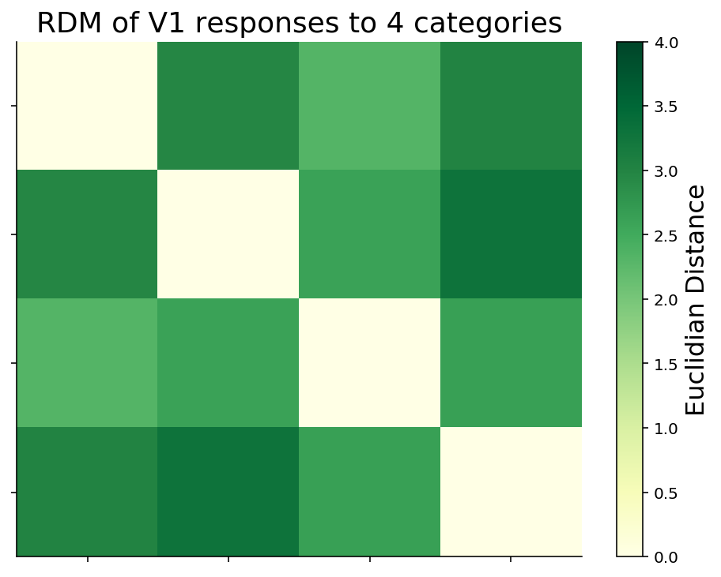
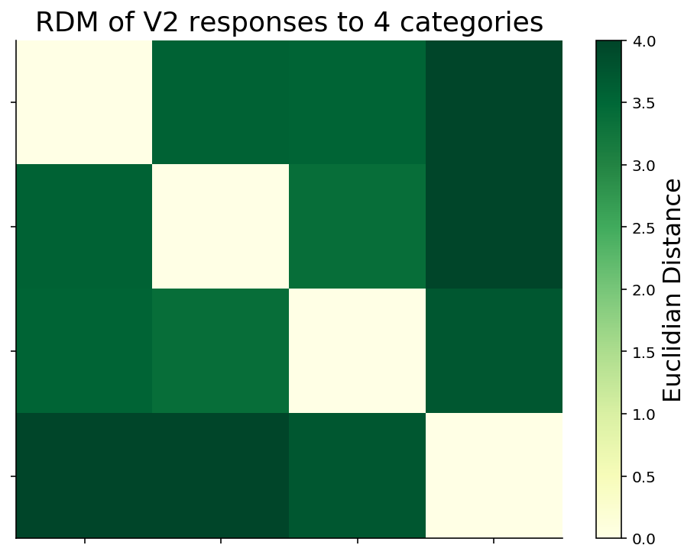
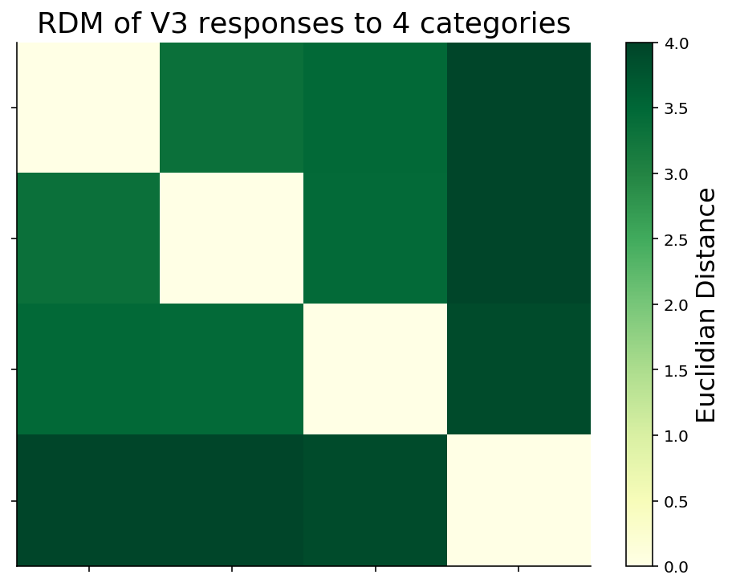
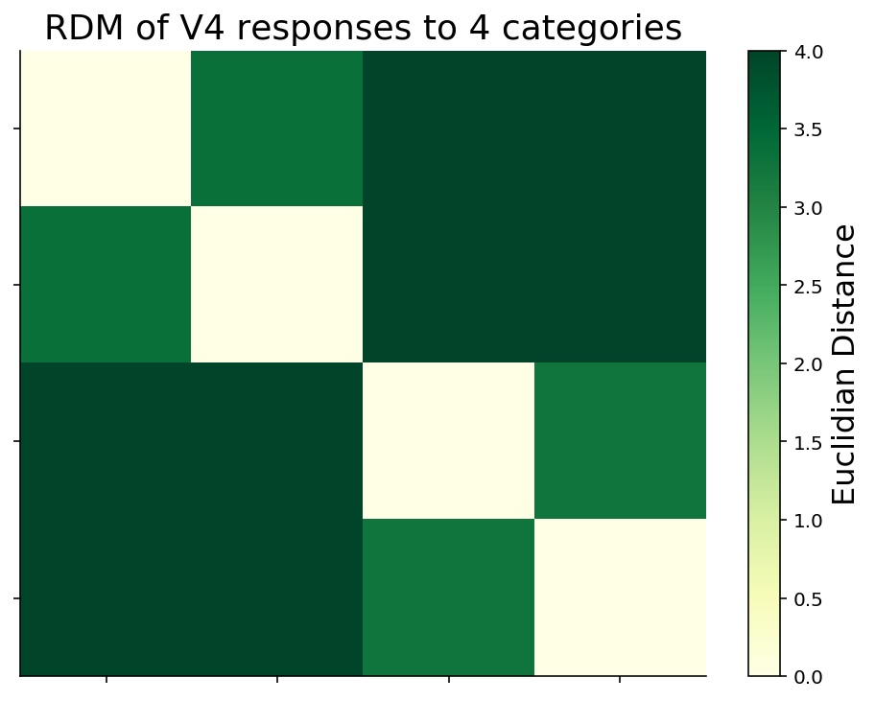
Compare neural network and brain in representational level
RDM of the fMRI responses after de-noise by averaging
fMRI data may be too noisy, so we average across stimuli within each categories and get a categories(4) x categories(4) matrix[top&middle right].
The distances between categories become longer from V1 to V4, implying that the representations of categories are gradually decoupled.
The distances within the two broad categories, i.e. “animate” and “inanimate”, gradually become shorter and cluster together from V1 to V4. This may imply the stimuli in the same semantic category elicit a prototypical response pattern, which is what we expect.
natural
natural
artificial
animals
human
natural
artificial
animals
human
inanimate
artificial
animals
animate
human
natural
artificial
animals
human
natural
artificial
animals
human
natural
inanimate
artificial
animals
animate
human

Slide 15
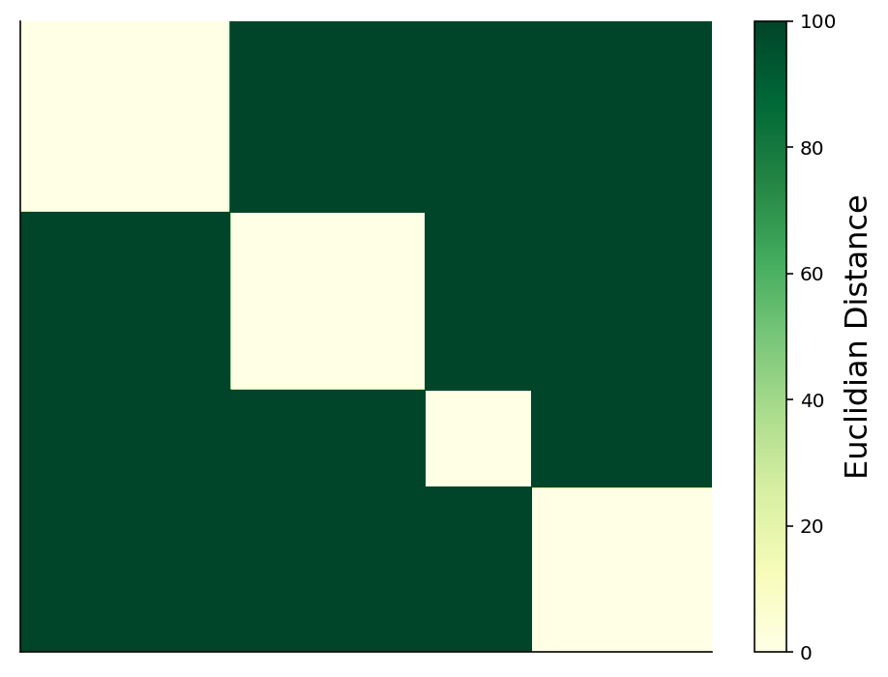
Compare neural network and brain in representational level
Neural network on this task
Use a pretrained Resnet-18 (He et al. 2016), a brain-like recurrent ANNs CORnet (Kubilius et al. 2018), a self-implement RCNN with biologically-plausible lateral and top-down connections (Spoerer et al. 2017).
Resnet-18 achieve 78% top-1 accuracy on test set, the accuracy of the other two models are chance-level. Thus we only compare the hidden activity between Resnet and brain in representational level.
Every layers of Resnet have the exactly same RDM, and the stimuli(1750) precisely clustered into these 4 categories [bottom right].
This may imply only 1 convolutional layer is enough to classify all stimuli. But with convolutional layers, only Resnet do this transfer learning task successfully.
RDM of all layers in Resnet
natural
inanimate
artificial
animals
animate
human
natural
artificial
animals
human
(Different size of the square is due to each category has different number of stimuli)

Slide 16
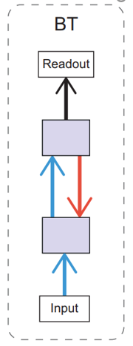
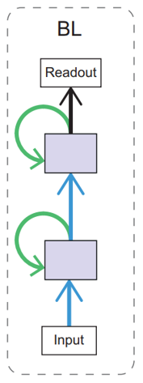
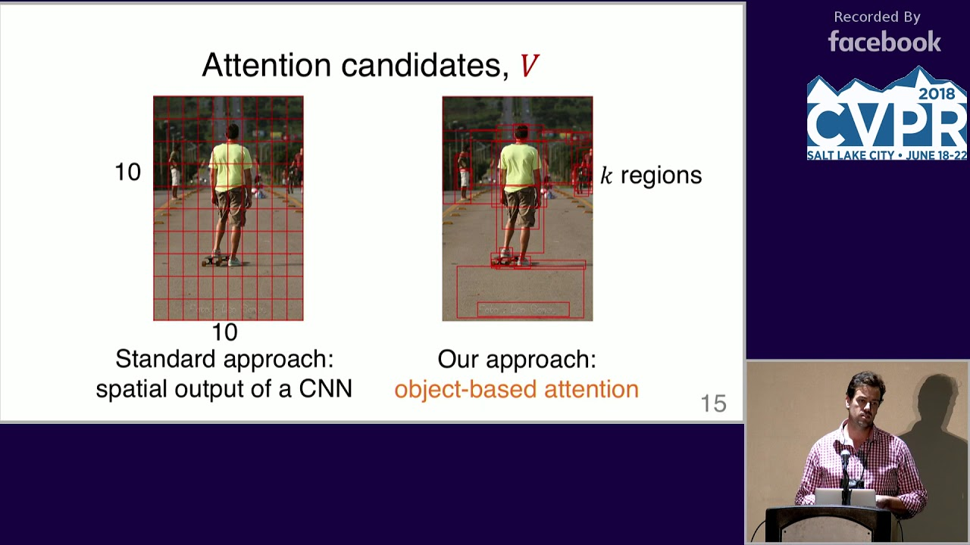
2. Add feedback to NN
Feedback mechanism
Lateral and top-down connections(Spoerer et al. 2017, Kubilius et al. 2019)
Top-down attention(Vaswani 2017, Lindsay & Miller, 2018)
Add feedback to NN and also compare representation dissimilarity matrix in different layers and performance.
Notes:
Attention explanations ：
https://buomsoo-kim.github.io/attention/2020/01/01/Attention-mechanism-1.md/
https://towardsdatascience.com/attention-in-neural-networks-e66920838742
https://pathmind.com/wiki/attention-mechanism-memory-network
https://www.youtube.com/watch?v=Q57rzaHHO0k
https://www.youtube.com/watch?v=quoGRI-1l0A&t=130s
https://www.youtube.com/watch?v=IxQtK2SjWWM

Slide 17
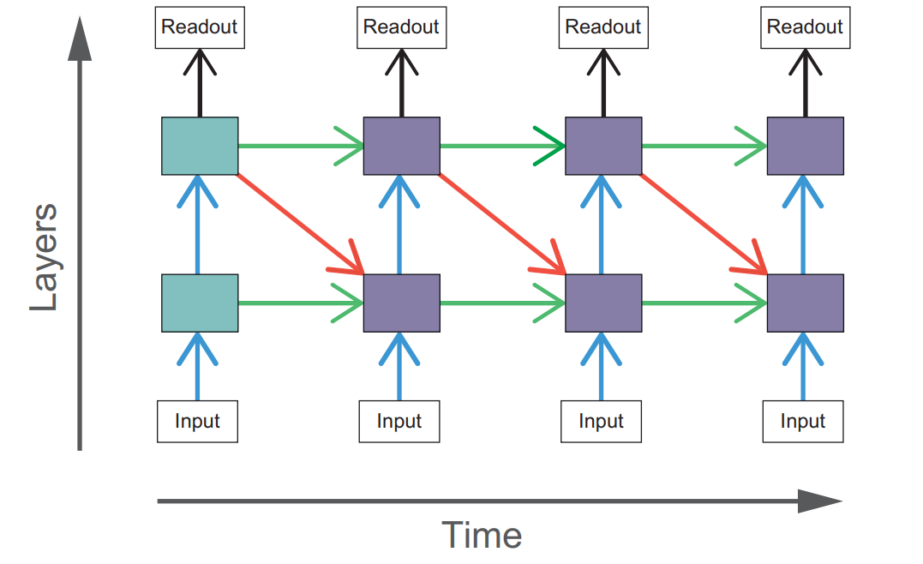
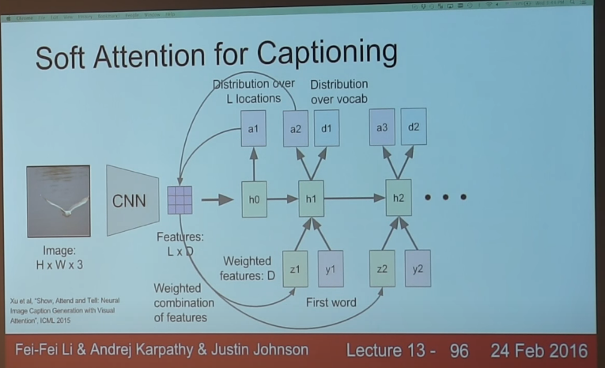
3. Add feedback loops to NN
CNN only looks at the whole image once:
Human seems to use attention like zoom lens, looks at different parts of image at each timesteps.
Add the same feedback mechanism to RNN(NN with timestep):
Recurrent computations to take place.
Add Poisson noises to each units to mimic noise in the brain.
Penalize time consuming: trade off between the noise added and information got.
Notes:
To train the network, error is backpropagated through time for each time point, which means that the network is trained to converge as soon as possible, rather than at the final time step.

Slide 18
4. Study how and why feedback works
Train biologically plausible neural networks to do cognitive tasks(HF Song et al. 2016, GR Yang et al. 2019, NY Masse et al. 2019, GR Yang & XJ Wang 2020):
Choose suitable cognitive tasks with and without presumed feedback mechanism.
Design neural network model with and without feedback.
Train designed neural network models to preform cognitive tasks.
Analysis.

Slide 19
Project topic: Complexity of feedback loops
Scientific context: We see from the neural circuitry that lateral and top-down feedback play a significant role in vision. Evidence shows that feedback in higher-level areas such as V4, IT, or MT, with bigger and more complex receptive fields, can modify and shape V1 responses. We also know that feedback plays a critical role in behavioral regulation. Using a variety of representational frameworks, how can we characterize this complexity? Does an intelligent agent (or organism) require a minimal (or maximum) level of representational complexity to produce and act upon feedback?
Specific question: Track 1 - How can you model top-down feedback in an artificial neural network for vision? Track 2 - What is the tradeoff between feedback and performance given representational models at different levels of complexity?
Data set: Track 1: CIFAR-10, ImageNet. Track 2: Mouse dataset (or EEG time-series) to train behavioral agent(s).
Techniques: Track 1: Recurrent neural networks; unsupervised learning; representation learning; autoencoders. Track 2: Bayesian model, Agent-based Model, or Reinforcement Learning.
Controls: Track 1: Feed forward architectures (like traditional CNNs). Track 2: No-representation feed-forward model of behavior.
Difficulty: Medium. Prereqs: Linear Regression. Cross-ref to course content: W2D3. Proposed by: Bradly Alicea, Edward Kim

Slide 20
Specify feedback
High-level
Abstract knowledge(JB Tenenbaum et al. 2011) or meta-information or internal model :
Ruled out: 1) No dataset; 2) Neural network can’t perform well on these task. 3) Bayesian hierarchical model can, but it can’t produce biological plausible information. 4) Don’t know how to devise tasks.
Task-specific(context) information(V Mante et al, 2013), e.g. Attention, goal (objective function):
We don’t know how to model these with abstracting out biological details.
Train biologically plausible neural networks to do cognitive tasks(HF Song et al. 2016, GR Yang et al. 2019, NY Masse et al. 2019, GR Yang & XJ Wang 2020):
Implementable, need specify which task involve feedback.
Low-level

Slide 21
Difficulty
What we want to do
What we do
Specify some tasks have feedback mechanism.
Study how feedback influences representation.
Train a NN perform the same task and approximate the RDM in brain.
Open the Blackbox, study the feedback in NN.
Use object detection task for simplicity.
Train a NN perform the task with and without feedback.
Compare two NN to see what does feedback do.
It’s seem far from what we want.
Notes:
但以上做法很困难：对于简单的，神经网络可以完成的任务，需要去说明什么样的任务存在反馈，或者需要反馈来完成；而对于可以不用说明需要反馈控制的任务，比如抽象知识，背景知识，系列决策，运动控制这样的任务，神经网络似乎又做不出来。

Slide 22
目标函数
人类的认知是为了意图和行动：比如视觉的目的不是为了物体识别，而是分析环境，为自己的行为计划。虽然人也完成了物体识别，但是这个物体识别只是一个副作用。
而机器学习算法不一样，它训练而来就是为了物体识别，而不是为了自己的意图和行动。
给定数据集，如果任务不一样，那么训练的网络肯定不一样。
能不能通过合理的设定任务，来分析不同目标下反馈有什么不一样的？

Slide 23
Specify research level
Computational
Because we don’t have enough knowledge about neuroscience, so we can’t study feedback in human(or mouse). What we want to explore is whether feedback helps neural network perform better.
Representational
Have well-developed method, easy to carry on.
Implementation
This is really fundamental, however, because we don’t have enough knowledge about neural circuit, we would abstract out this level.

